Slide 1


COMP7940 Group Project - Group N
A Scalable Telegram Chatbot with Multi-LLM Failover
Cloud-based design
Automated deployment
Interaction Logging
Telegram Chatbot ID: @fishhedebot Group Members and IDs: Haoran HE, 25421484
Haichuan NING, 25407740
Zijian ZHOU, 25421859
Notes:
Hello everyone, welcome to our presentation. Today, we will introduce our group project: a scalable Telegram chatbot with multi-LLM failover. We built a Telegram chatbot that keeps the user side stable, while the backend side can switch across different LLM services with logging, failover, and automated cloud deployment. Let's dive in.

Slide 2

Agenda
01 Project Background & Goal
02 System Architecture
03 User Flow & Main Functions
04 Reliability & Scalability
05 Backend & LLM Integration
06 Database & Logging
07 DevOps, Security & Requirement Match
08 Conclusion
Notes:
Here's the agenda for today's presentation. We will start with the project background and goals, then move on to the system architecture, user flow, and key features. We'll discuss the system's reliability and scalability, followed by the backend design and LLM integration details. Finally, we'll cover the database, logging, DevOps practices, and conclude with a summary.

Slide 3

Project Background and Goal
We built a Telegram chatbot for cloud deployment and LLM-based conversation.
Telegram is stable for user access, but LLM APIs may change, fail, or need replacement.
Our goal is to keep the bot service running while allowing backend APIs to be changed easily.
Cloud-based LLM Chatbot
The project also shows cloud practice in deployment, logging, security, and cost awareness.
Notes:
Our project focuses on building a Telegram chatbot designed for cloud deployment and powered by Large Language Models.

Slide 4
System Architecture
Frontend Container
Include:
MongoDB
Chatbot
Backend 1
Backend 2
Backend x+1…
Frontend for Telegram
Which Communicate with Telegram API and Backend containers.
MongoDB
That can store chat records from frontend.
Multiple Backend
Each individual backend container can use different models, API settings.
This modular design makes extension and replacement easier.
All Backend & Frontend Container in Single Host
Notes:
The system architecture is designed for flexibility.

Slide 5
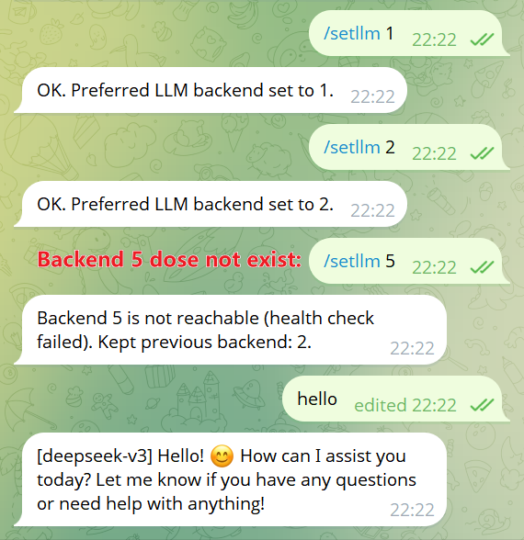
User Flow and Main Functions
In a Backend Server:
Status & Failover Info (/health)
When we create a new backend server, it will create a page “/heath” which is an API for frontend server to check the status of it.
In a Frontend Server:
Backend Selection:
In telegram chatbot, we can use setllm to select different backend server.
Frontend Server will check backend health when user send setllm command.
If frontend server fail to check the health of it, it will reject the setllm command.
Notes:
The user experience is straightforward.

Slide 6
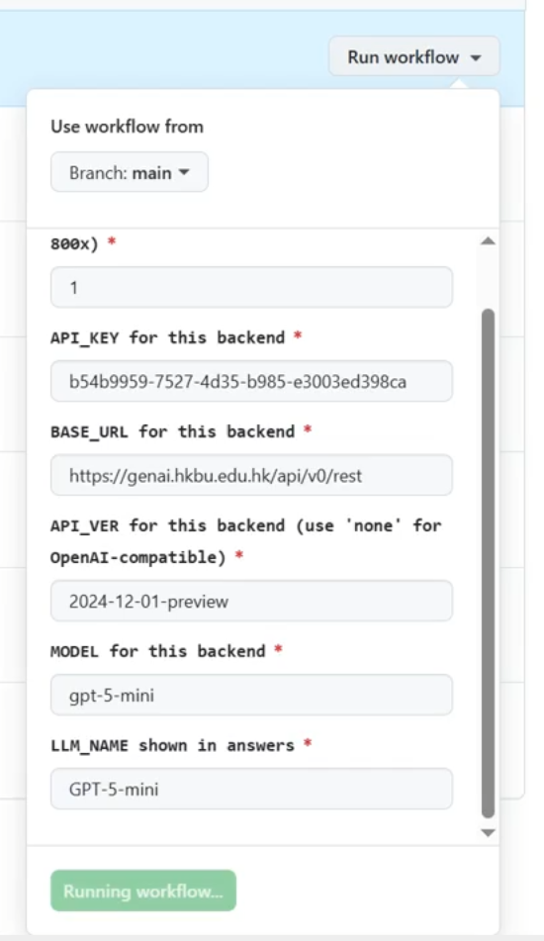
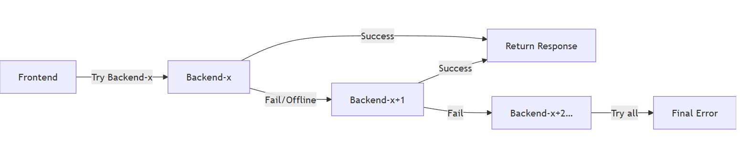
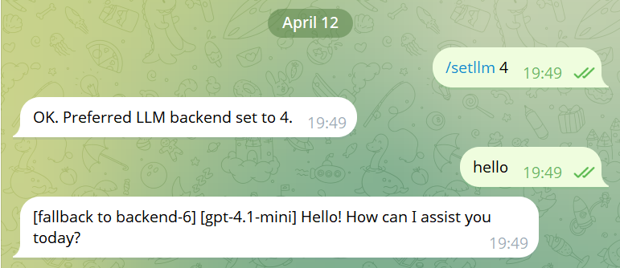
Reliability and Scalability
Backend 4: a problem backend was created for testing
Scalability If we want to create new backend server, we just simply use an unused backend id and then create, the frontend server should be able to use the new backend without restart.
if we want to fix the problem backend server, just replace the problem backend server by using the same ID.
High availability of services:
The chatbot will still available when there's only one backend server online, When backend fail to communicate with GenAI Server, it tries the next backend ID until reach the max number we set in Frontend server.
Notes:
The core feature of our design is its reliability and scalability.

Slide 7
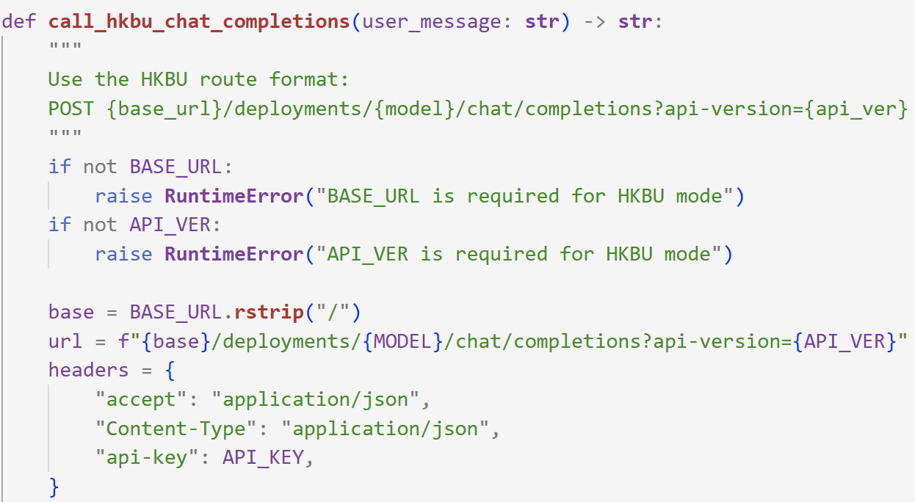
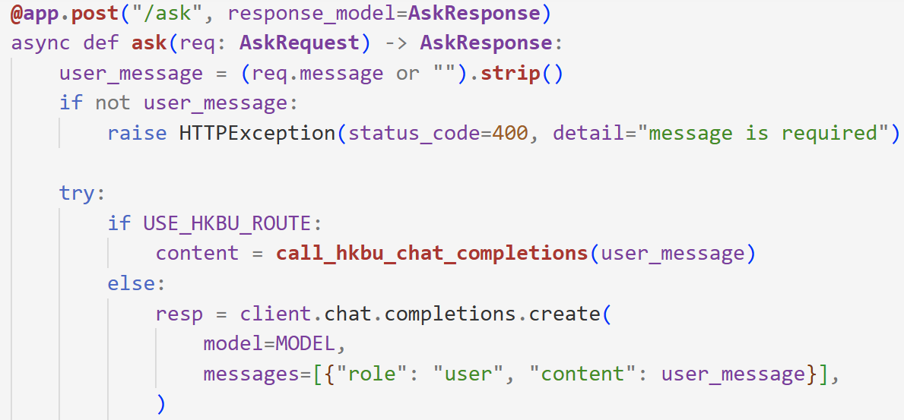
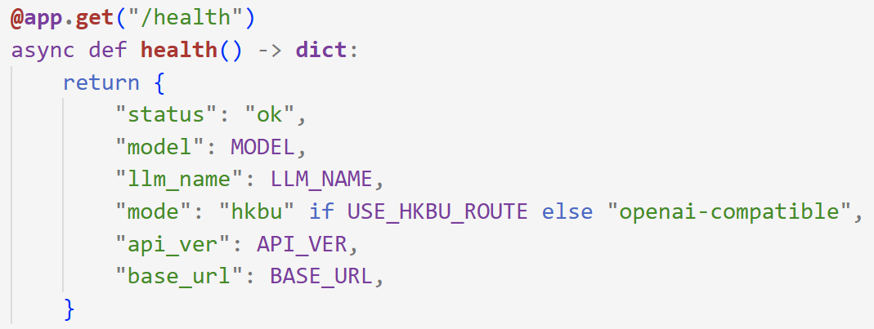
Backend Design and LLM Integration
Independent configuration unit Each backend has its own API key, base URL, API version, model, and shown name.
Flexible connectivity One backend can connect to one LLM provider or model setting.
Multi-API compatibility The backend supports both HKBU-style API routes and OpenAI-compatible APIs.
Response traceability The answer is returned with an LLM name prefix for clear identification.

Slide 8
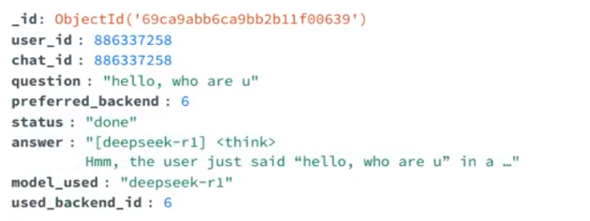
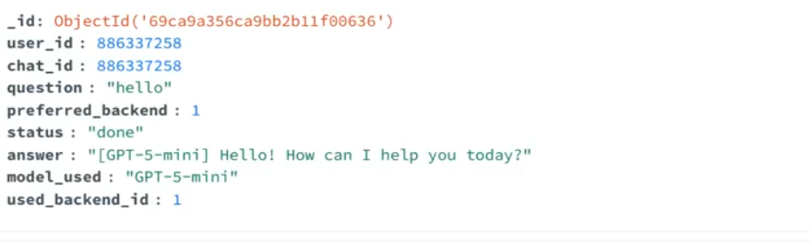
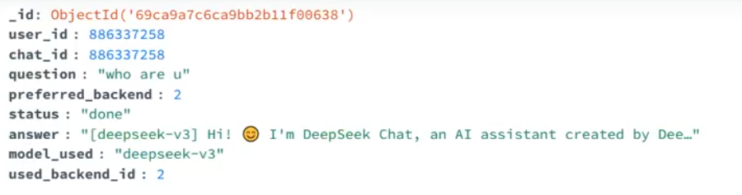
Database and Logging
MongoDB Core Storage
MongoDB stores user settings and chat records.
Log Details
Each record keeps the question, answer, preferred backend, used backend, model, status, and error.
Comprehensive Recording
Both successful and failed requests are logged.
Robust Infrastructure
Operational Intelligence
This improves debugging, monitoring, and post-incident analysis.
Notes:
We use MongoDB to persist user settings and detailed chat logs.

Slide 9

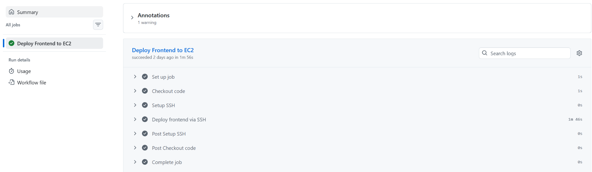
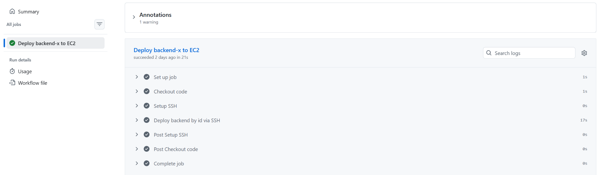
DevOps, Security, and Requirement Match
Docker containerization management Docker is used for the bot, backend services, and MongoDB.
GitHub Actions Automated Deployment GitHub Actions deploys frontend and backend services to AWS EC2.
Runtime security key policy Secrets are passed at runtime instead of being stored in the repository.
Telegram Bot & Cloud Services
Zero cost and full demand coverage The project covers Telegram, LLM API, database logging, cloud hosting, containers, Git, and automated deployment. The cloud cost is about 0 USD.
Notes:
Our project embraces DevOps principles.

Slide 10

Conclusion
Practical Our project presents a practical cloud chatbot system.
Reliable It is modular, reliable, and easy to extend.
Robust Deployment
Its main strength is multi-backend failover with simple deployment.
Thank you.
Notes:
In conclusion

